Slide 1
USGS
NDBC

Slide 2
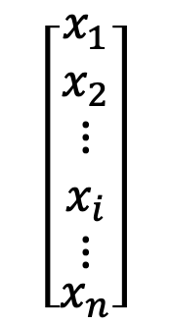
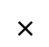
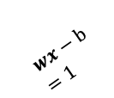
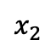
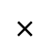
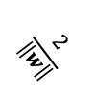
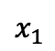
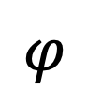
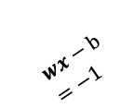
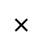
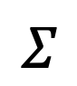
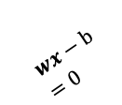
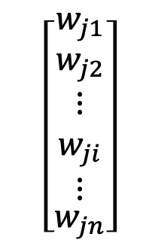
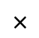
$$x_{2}$$
$$wx−b=1$$
a.
$$wx−b=0$$
$$wx−b=−1$$
$$\frac{2}{\left\|w\right\|}$$
$$x_{1}$$
b.
Diagram of neuron j in layer L
$$×$$
$$\left[\begin{matrix}x_{1} \\ x_{2} \\ \begin{matrix}\begin{matrix}\begin{matrix}⋮ \\ x_{i}\end{matrix} \\ ⋮\end{matrix} \\ x_{n}\end{matrix}\end{matrix}\right]$$
$$\left[\begin{matrix}w_{j1} \\ w_{j2} \\ \begin{matrix}\begin{matrix}\begin{matrix}⋮ \\ w_{ji}\end{matrix} \\ ⋮\end{matrix} \\ w_{jn}\end{matrix}\end{matrix}\right]$$
$$×$$
activation
function
$$Σ$$
$$φ$$
activation
$$×$$
transfer
function
$$×$$
threshold

Slide 3
a.
b.

Slide 4
a.
b.

Slide 7
 |  | K-fold cross validation | Block cross-validation
SVM | HAB accuracy | 0.63 | 0.38
 | Non-HAB acc. | 0.85 | 0.76
 | Total accuracy | 0.78 | 0.62
Naïve Bayes (NB) | HAB accuracy | 0.65 | 0.61
 | Non-HAB acc. | 0.56 | 0.47
 | Total accuracy | 0.59 | 0.52
RVM | HAB accuracy | 0.54 | 0.60
 | Non-HAB acc. | 0.71 | 0.60
 | Total accuracy | 0.66 | 0.61
ANN | HAB accuracy | 0.42 | 0.29
 | Non-HAB acc. | 0.76 | 0.74
 | Total accuracy | 0.65 | 0.60

Slide 8
Station Name | Covariance between N-S and E-W Components
Venf1 | -0.021
Cdrf1 | 0.186
x42039 | 0.032
x42003 | -0.024
We need captions for the tables and indication in text where they relate.

Slide 9
The rest is extra!

